Slide 1
ME469: A Verification and Validation (V&V) Methodology: Laboratory
Stefan P. Domino^{1,2}
¹ Computational Thermal and Fluid Mechanics, Sandia National Laboratories
² Institute for Computational and Mathematical Engineering, Stanford
SAND2018-4536 PE

Slide 2
Focus on Three Nalu/reg_tests/test_files/laboratory
2d_quad9_couette
2d_quad4_channel
3d_tet4_pipe

Slide 3
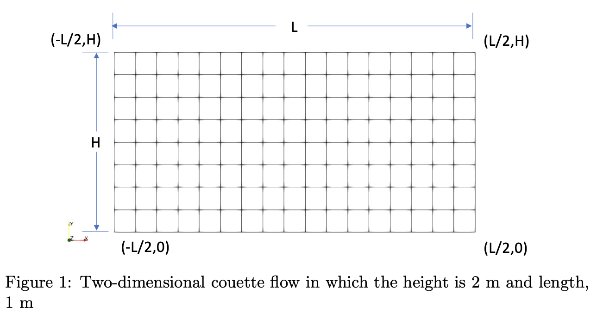
Nalu/reg_tests/test_files/laboratory/2d_quad9_couette: Geometry/Boundary Conditions
Top, imposed velocity
Bottom, no-slip wall
Left and right sides, periodic

Slide 4
Nalu/reg_tests/test_files/laboratory/2d_quad9_couette: Equations
Subject to the imposed conditions, the momentum equation reduces to:
With analytical solutions (at a given Reynolds number):
Simple, and a linear profile

Slide 5
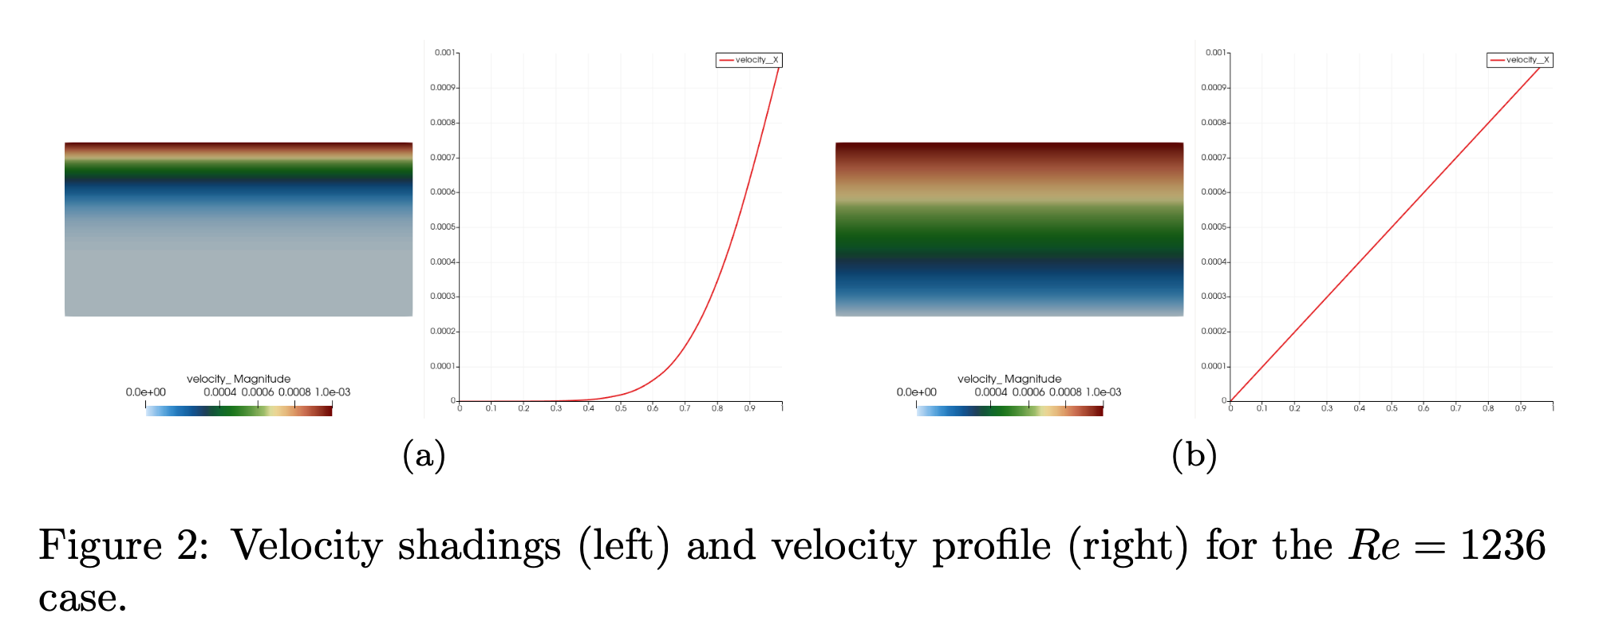
Nalu/reg_tests/test_files/laboratory/2d_quad9_couette: Simulation Results
Start-up adds additional complexity to the solution, however, at steady state, our profile is predicted to be linear

Slide 6
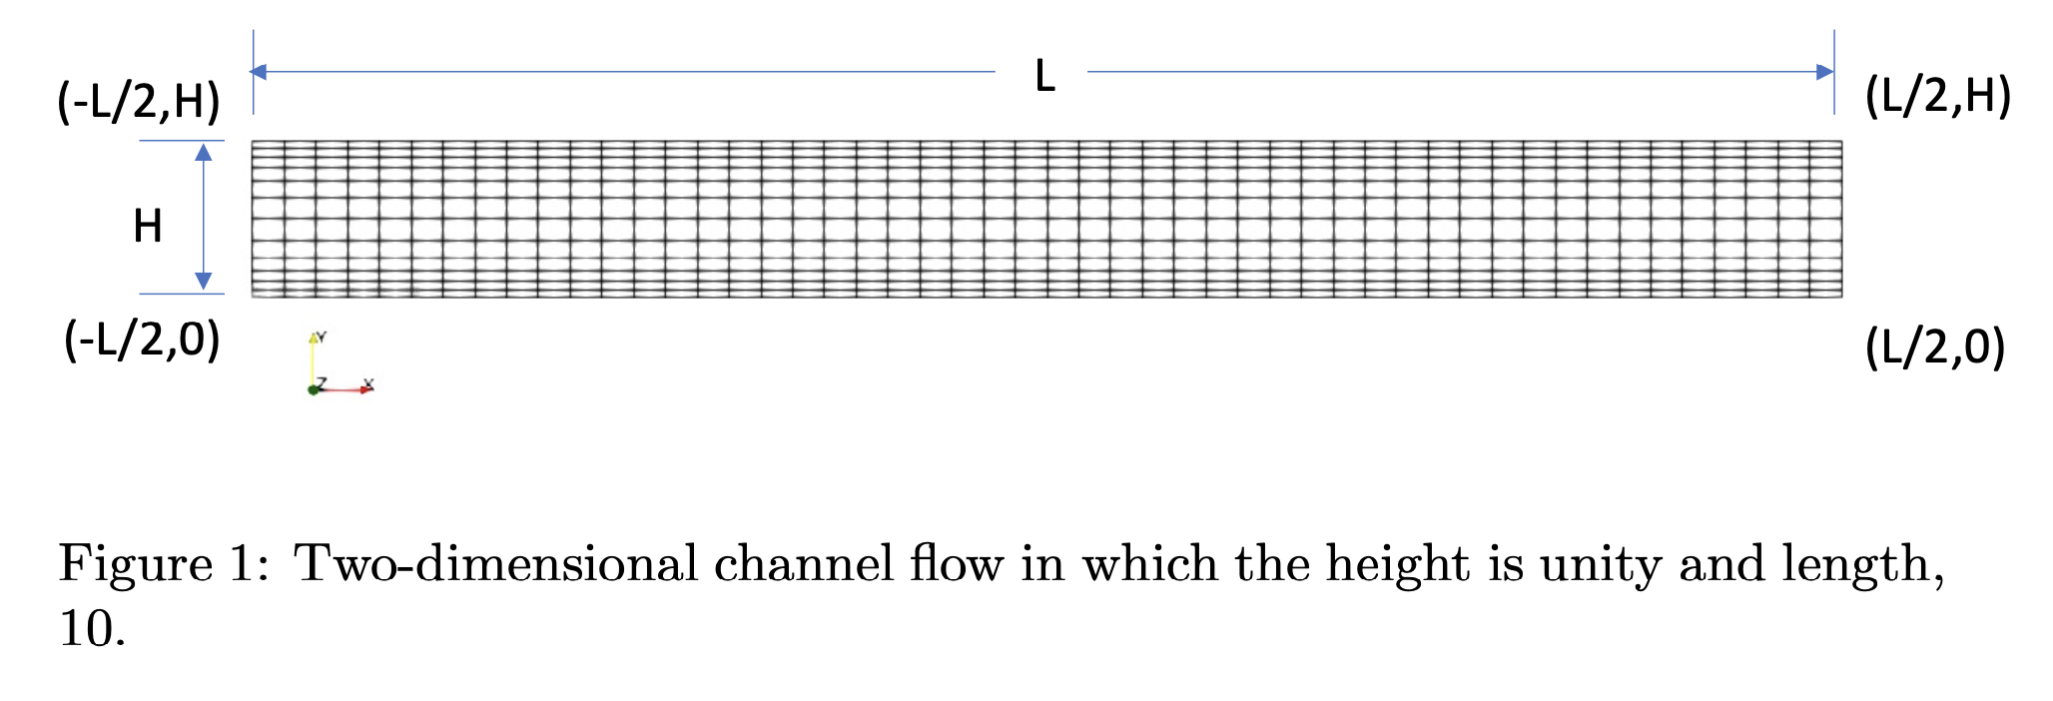
Nalu/reg_tests/test_files/laboratory/2d_quad4_channel: Geometry/Boundary Conditions
Top and bottom, no-slip wall
Left and right sides, either open (specified pressure drop) or with a body force, periodic

Slide 7
Nalu/reg_tests/test_files/laboratory/2d_quad4_channel: Equations
Subject to the imposed conditions, the momentum equation reduces to:
With analytical solutions (at a given Reynolds number):
Quadratic profile
Wall shear stress and pressure gradient balance:

Slide 8
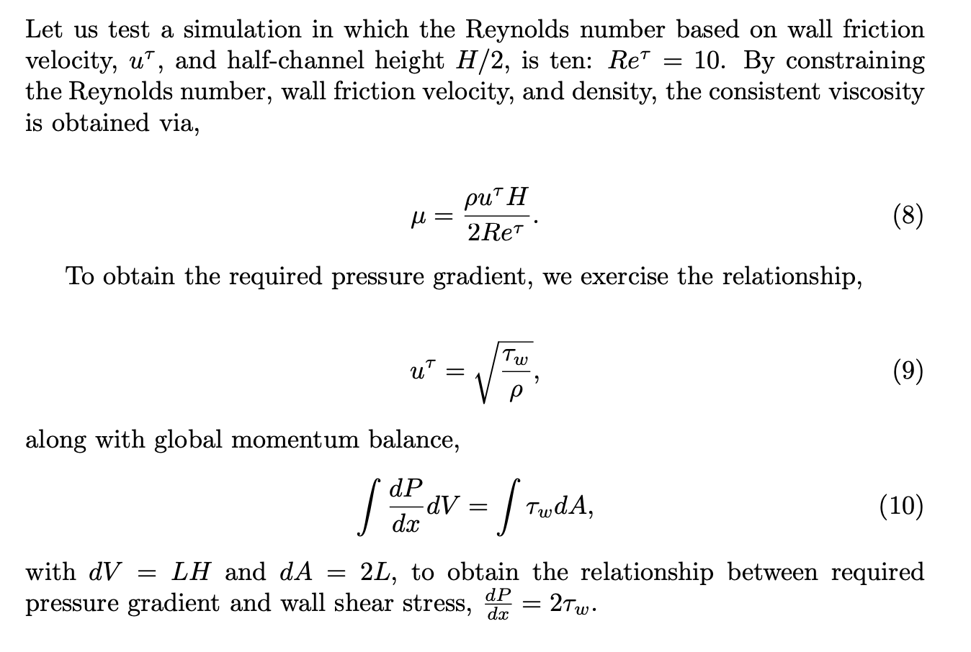
Nalu/reg_tests/test_files/laboratory/2d_quad4_channel: Sizing
Let’s run at Re_{τ}=10
Reynolds number:
Ratio of inertial to viscous forces
In this channel, define Reynolds number based on the wall friction velocity, u_{τ} (at H/2 length scale)

Slide 9
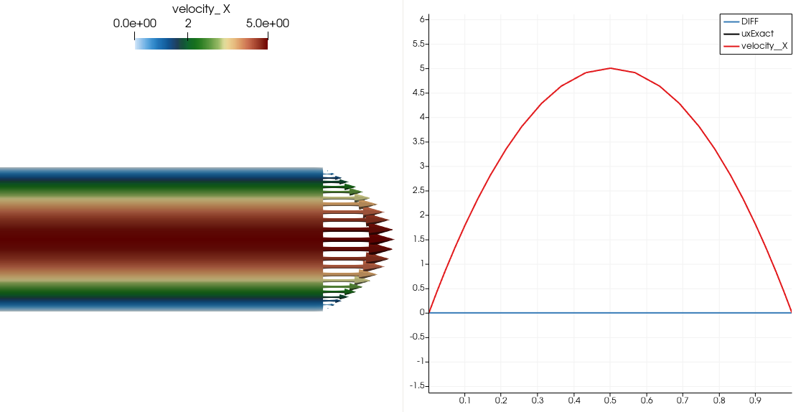
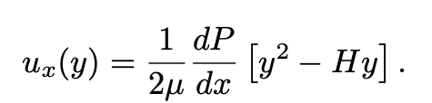
Nalu/reg_tests/test_files/laboratory/2d_quad4_channel: Simulation Results
Analytical Expression:
Zero Error when evaluating the norm at the nodes (in general, we may integrate over a domain and choose integration points that are not nodally-lumped
However, the wall shear stress is not – why?

Slide 10
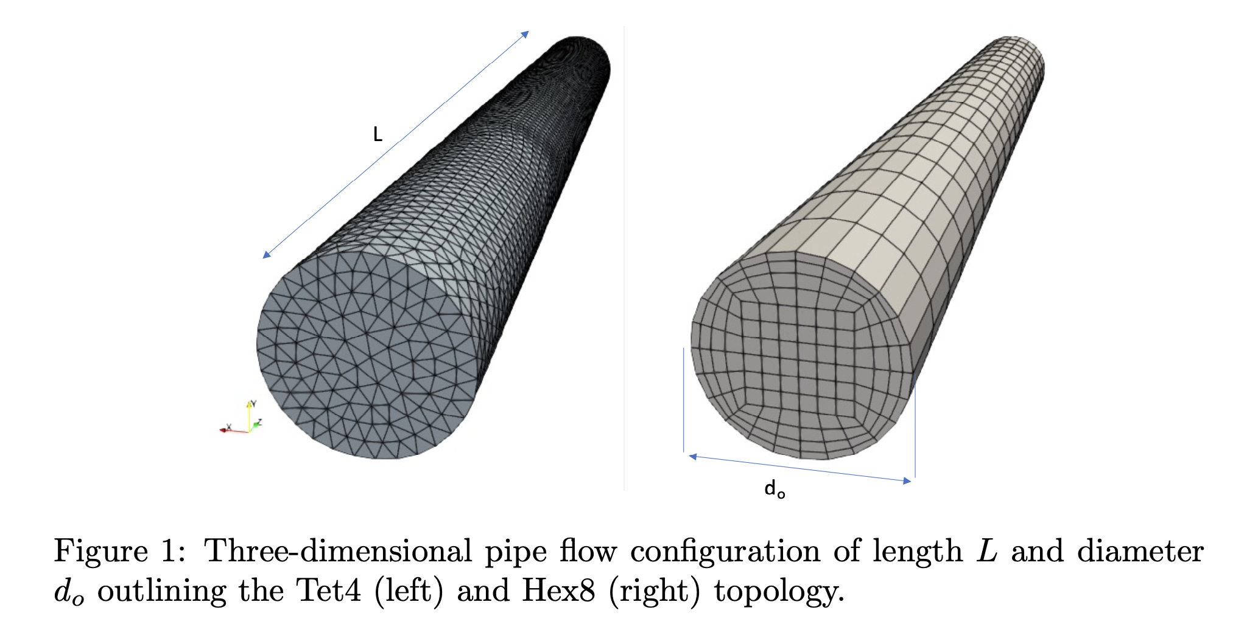
Nalu/reg_tests/test_files/laboratory/3d_tet4_pipe: Geometry/Boundary Conditions
No-slip (walls) outer pipe
Periodic (left and right) with a constant body force …or… Open (left and right pressure drop)

Slide 11
Nalu/reg_tests/test_files/laboratory/ 3d_tet4_pipe: Equations
Subject to the imposed conditions, the axial momentum equation (cylindrical coordinates) reduces to:
With analytical solutions (at a given Reynolds number):
Quadratic profile
Wall shear stress, and pressure gradient balance

Slide 12
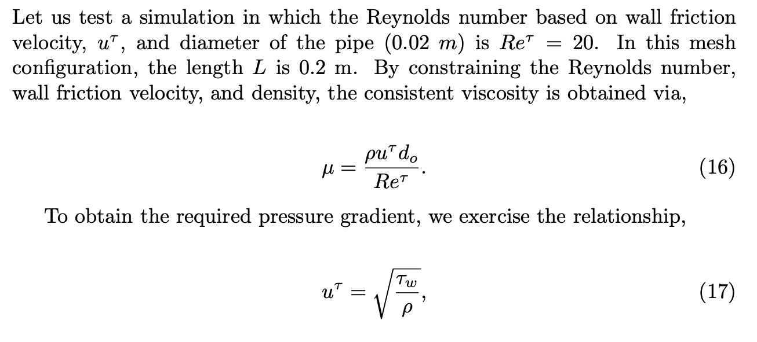
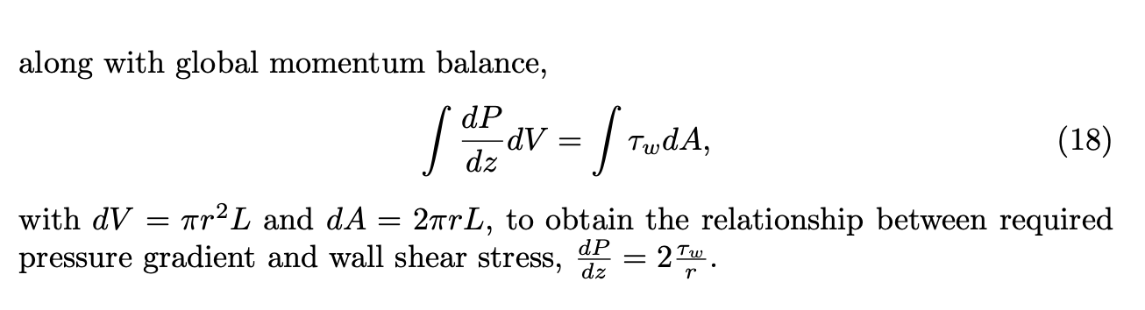
Nalu/reg_tests/test_files/laboratory/ 3d_tet4_pipe: Sizing
Let’s run at Re_{τ}=20
Reynolds number:
Ratio of inertial to viscous forces
In this channel, define Reynolds number based on the wall friction velocity, u_{τ} (at d_{o} length scale)

Slide 13
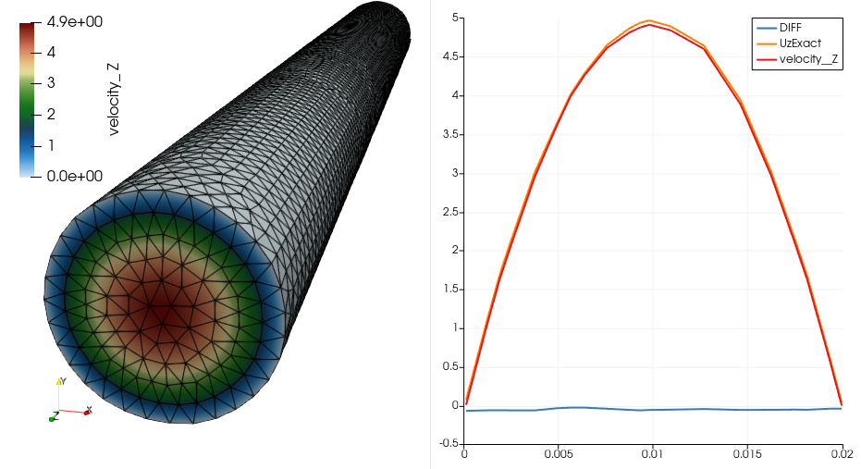
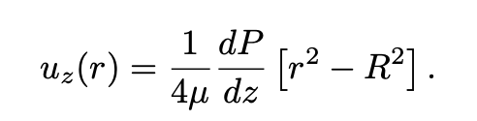
Nalu/reg_tests/test_files/laboratory/2d_quad9_channel: Simulation Results
Analytical Expression:
Non-zero error when evaluating the norm at the nodes…

Slide 14
Nalu/reg_tests/test_files/laboratory/2d_quad9_channel: Simulation Results
Analytical Expression:
Non-zero error when evaluating the norm at the nodes…
What happened?

Slide 15
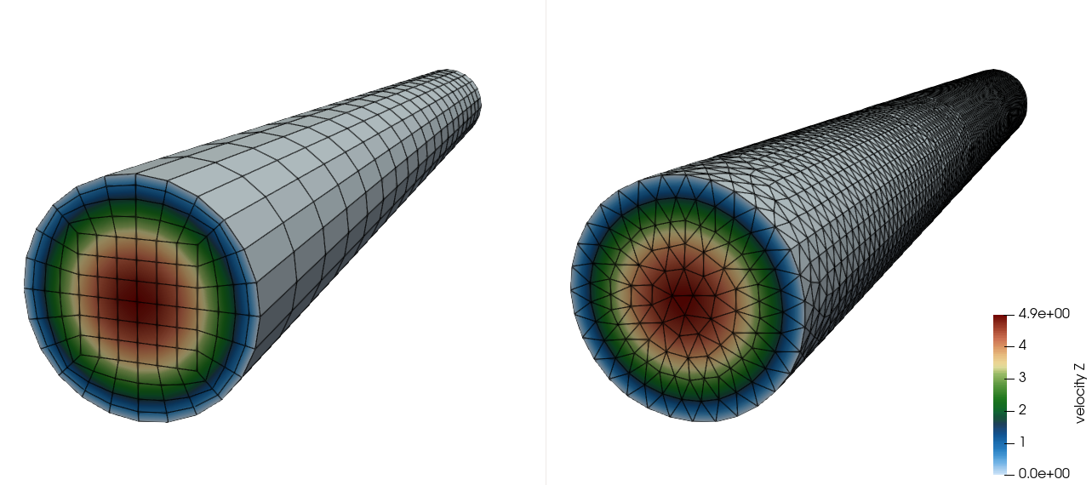
Nalu/reg_tests/test_files/laboratory/2d_quad9_channel: What About Tet4 vs Hex8?

Slide 16
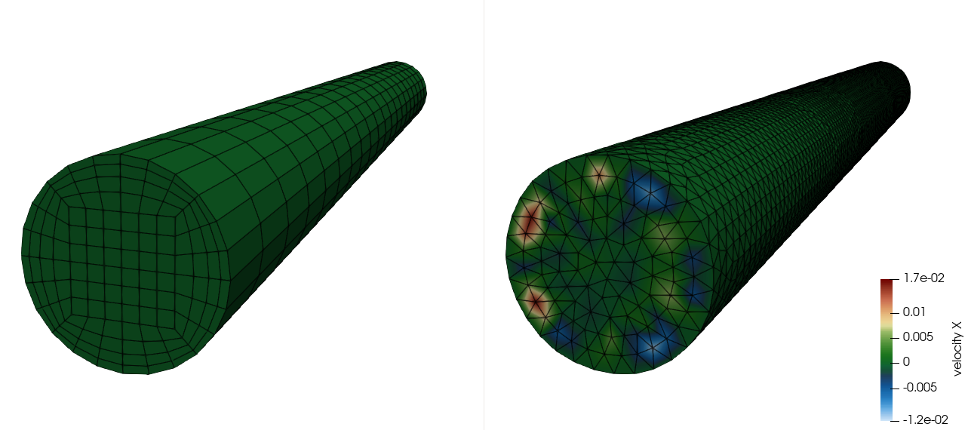
Nalu/reg_tests/test_files/laboratory/2d_quad9_channel: What About Tet4 vs Hex8?
~0.3% error in non-streamwise velocity components in the tet-based result, ~0% for Hex8!!!

Slide 17
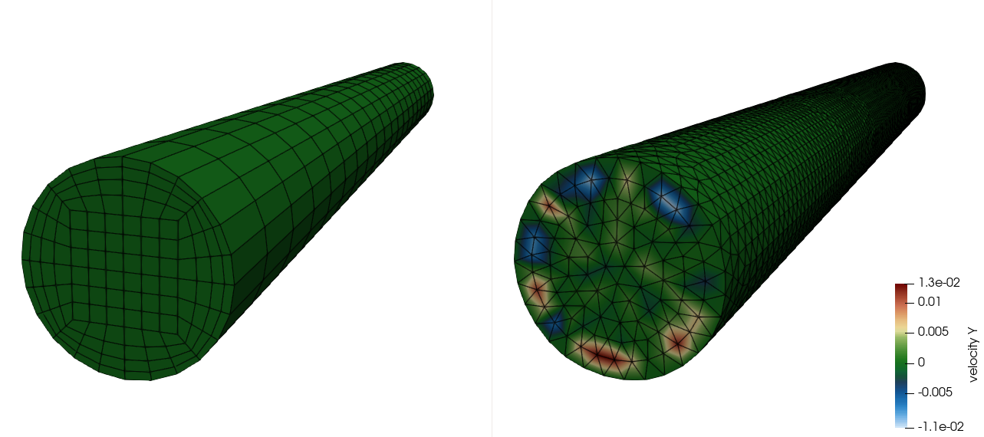
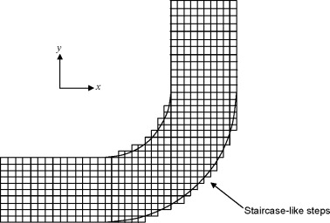
Nalu/reg_tests/test_files/laboratory/2d_quad9_channel: What About Tet4 vs Hex8?
Jiyuan Tu, Guan-Heng Yeoh, Chaoqun Liu,
Chapter 4 - CFD Mesh Generation: A Practical Guideline,
Editor(s): Jiyuan Tu, Guan-Heng Yeoh, Chaoqun Liu,
Computational Fluid Dynamics (Third Edition),
Butterworth-Heinemann, 2018, Pages 125-154,
~0.3% error in non-streamwise velocity components in the tet-based result, ~0% for Hex8!!!

Slide 18
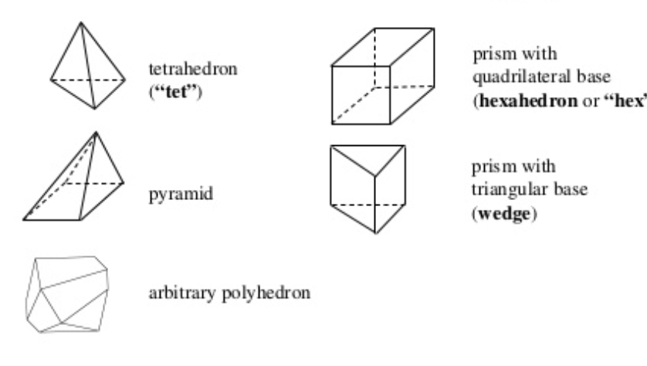
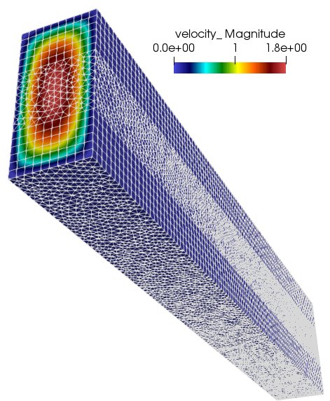
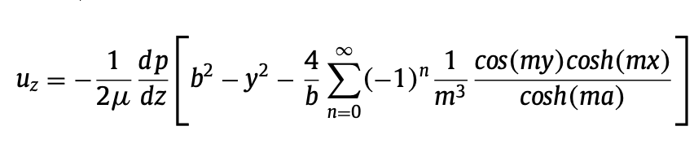
Unstructured Mesh Types (Review) and Results
Hex8
Tet4
Pyramid5
Wedge6
Domino et al., “An assessment of atypical mesh topologies for low-Mach large-eddy simulation”, Computers & Fluids, 2019
Design order…..

Slide 19
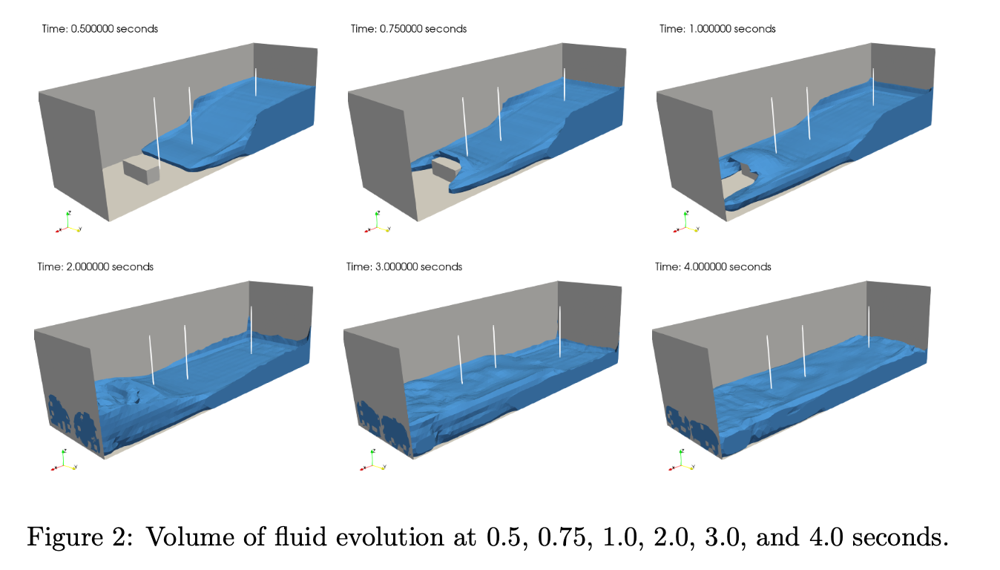
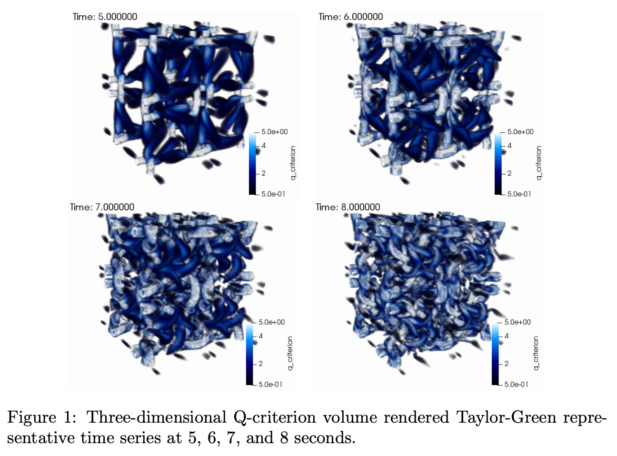
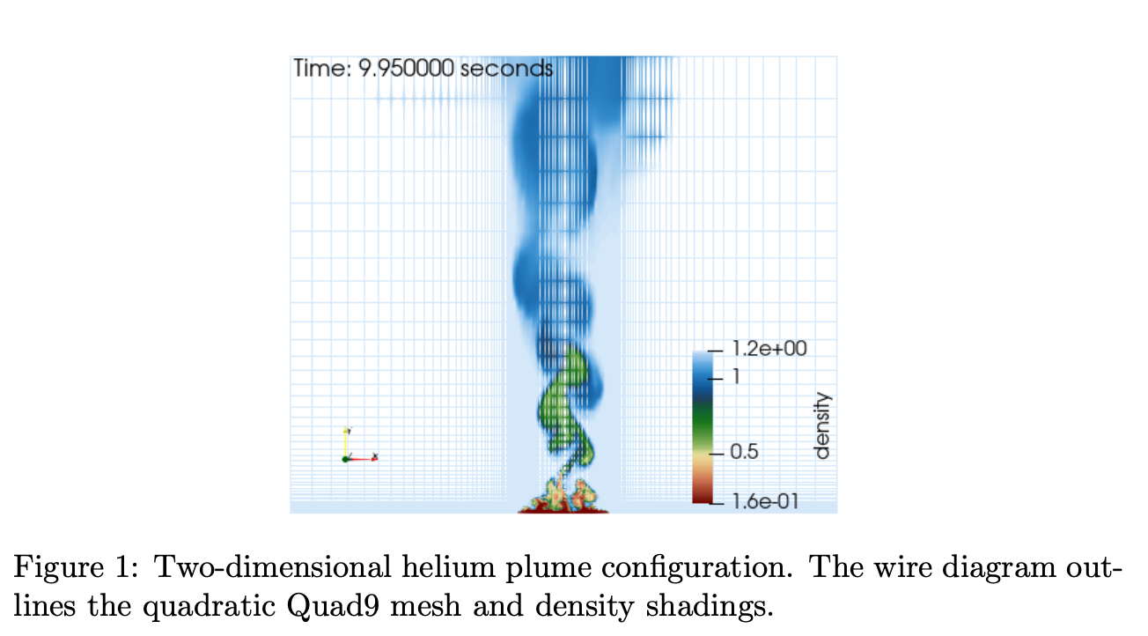
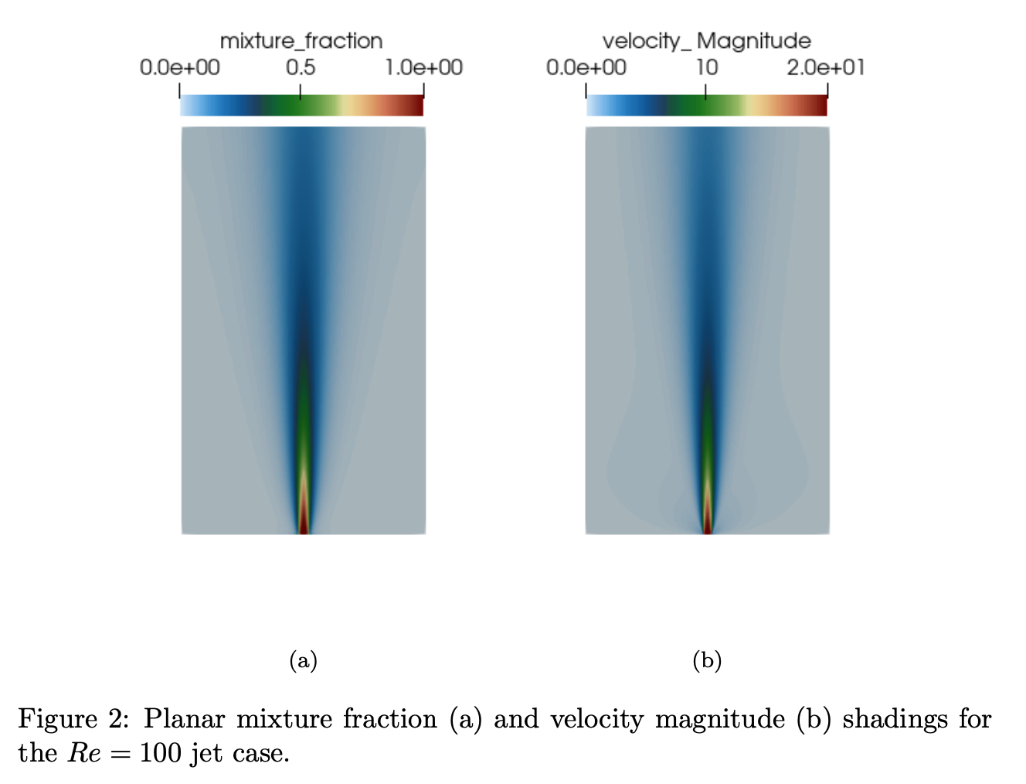
Conclusions
In low-Mach fluid mechanics, we have a limited set of analytical solutions that can be used to ensure that neither coding nor conceptual discretization-like mistakes have been made
In this module, we have reviewed three of the simplest cases
As complexity increases, the method of manufactured solution (MMS) becomes. Powerful tool to ensure that the numerical scheme is converging as expected
Other labs: dam break, Taylor Green decay, helium plume, open jet (see /laboratory for more)

